Slide 1

Sprint -1
Rajan Kumar

Slide 2
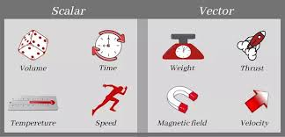
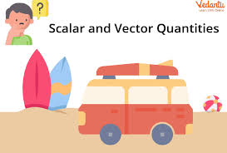
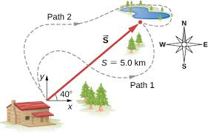
Vectors and Scalars

Slide 3
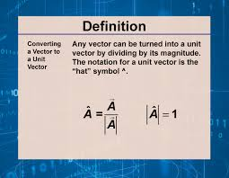
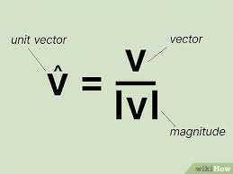
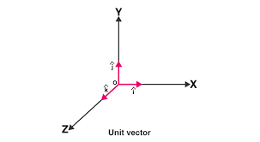
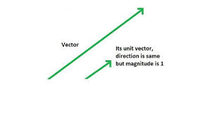
Unit vector

Slide 4
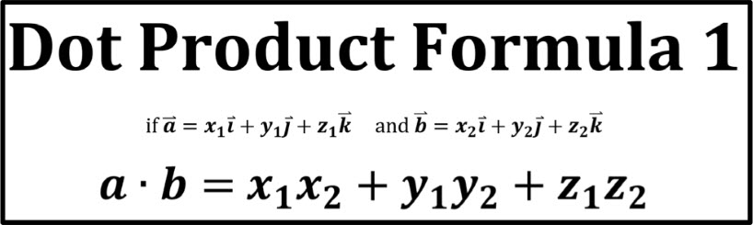
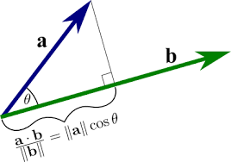
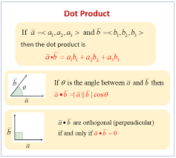
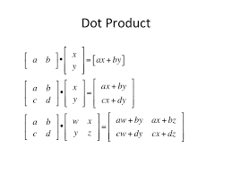
Dot product

Slide 5
If dot product:
Positive- means their components are adding, same direction.
Zero- vectors are perpendiculars.
Negative- means their components are getting subtracted, opposite direction.

Slide 6
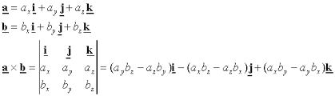
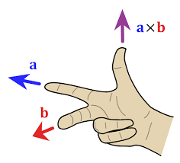
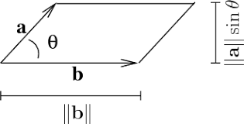
Cross Product

Slide 7
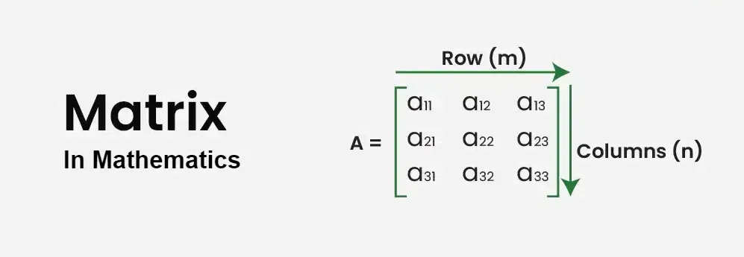
Matrices
Matrices, the plural form of a matrix, are the arrangements of numbers, variables, symbols, or expressions in a rectangular table that contains various numbers of rows and columns.
They are rectangular-shaped arrays, for which different operations like addition, multiplication, and transposition are defined.

Slide 8
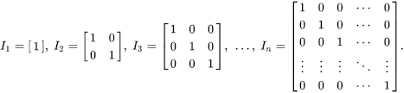
Identity matrix
An identity matrix, sometimes called a unit matrix, is a diagonal matrix with all its diagonal elements equal to 1 , and zeroes everywhere else.
The letter I is usually used to label identity matrices.
Multiplicative identity, inverse of itself, det(I)=1.

Slide 9
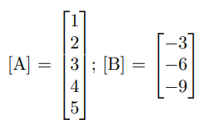
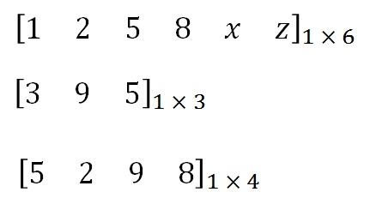
Column Matrix and Row Matrix
The column matrix has elements arranged in a vertical manner, and the row matrix has elements arranged in a horizontal manner.
The order of a column matrix is n × 1, and the order of a row matrix is 1 × n.
Column Matrix
Row Matrix

Slide 10
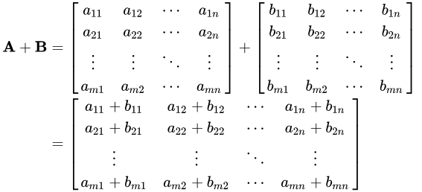
Matrix Addition
Matrix addition is the operation of adding two matrices by adding the corresponding entries together.
Two matrices must have an equal number of rows and columns to be added.
The sum of A and B, denoted A + B, is computed by adding corresponding elements of A and B.

Slide 11
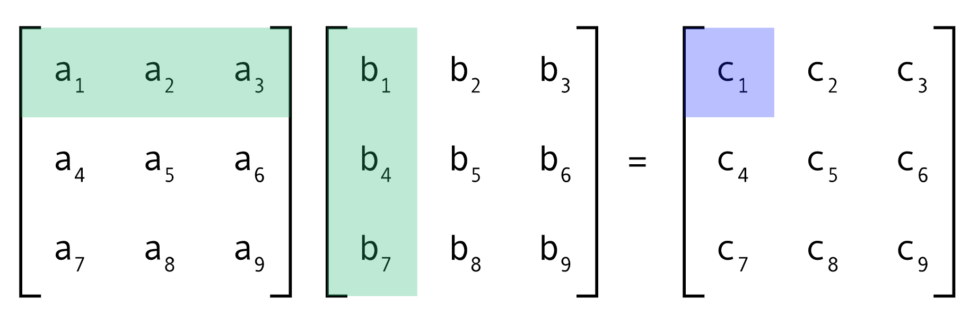
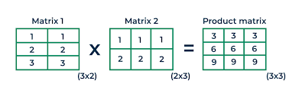
Matrix Multiplication
For matrix multiplication, the number of columns in the first matrix must be equal to the number of rows in the second matrix.
The resulting matrix, known as the matrix product, has the number of rows of the first and the number of columns of the second matrix. The product of matrices A and B is denoted as AB.

Slide 12
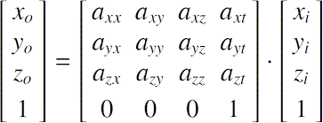
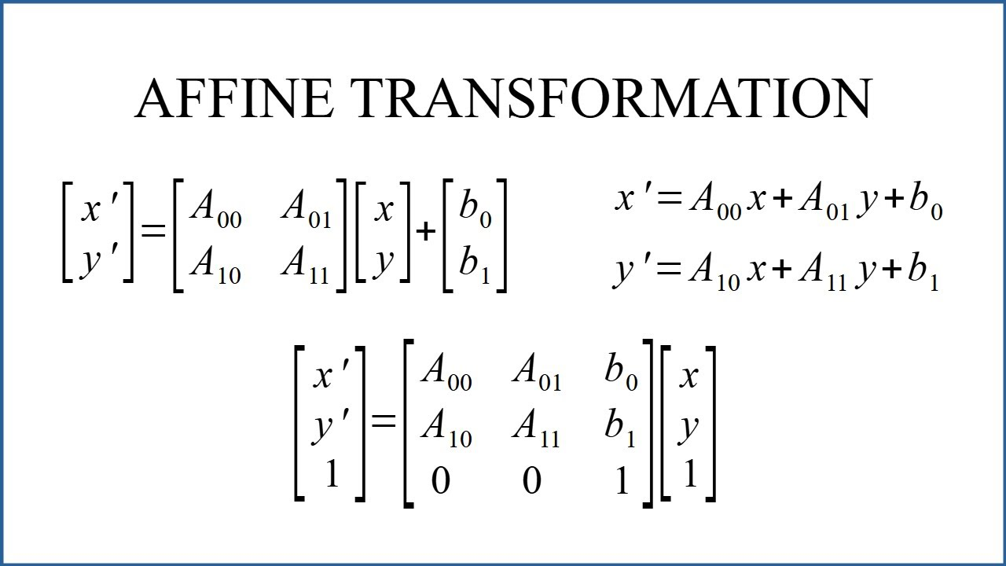
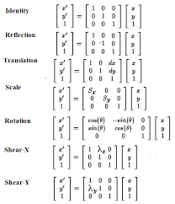
Affine Transformation
Affine transformation is a linear mapping method that preserves points, straight lines, and planes. Sets of parallel lines remain parallel after an affine transformation.
The affine transformation technique is typically used to correct for geometric distortions or deformations.

Slide 13
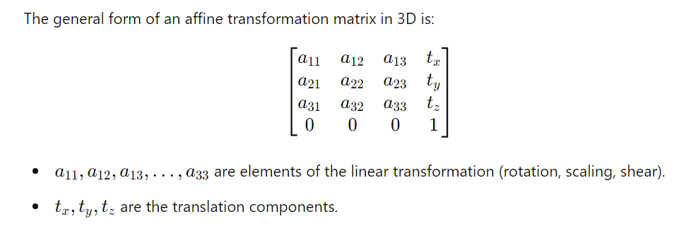
Affine Transformation in 3D
An affine transformation in 3D is a combination of linear transformations (such as rotation, scaling, or shear) and a translation. It can be represented using a 4x4 matrix to operate on 3D coordinates expressed in homogeneous coordinates. This matrix can apply various transformations to a 3D point, including changing its position, size, and orientation.
.

Slide 14
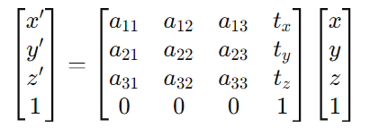
Applying the Transformation
To transform a point (𝑥, 𝑦, 𝑧), first convert it to homogeneous coordinates: (𝑥, 𝑦, 𝑧, 1). Then, multiply it by the transformation matrix:
.
Where (x ′ ,y ′ ,z ′ ) are the transformed coordinates.
1 represents normalised or standard coordinate system. (No scaling)

Slide 15
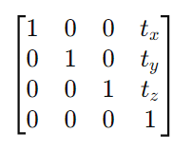
Types of transformation
Translation: Shifts the position of the object.

Slide 16
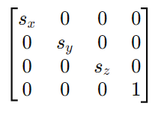
2. Scaling: Changes the size of the object.

Slide 17
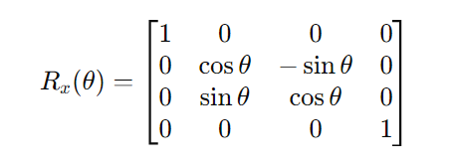
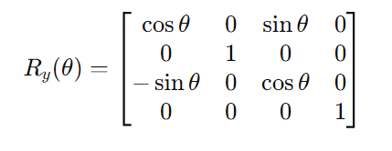
3. Rotation
Rotation about X-axis.
A rotation by an angle 𝜃 about the x-axis affects the y and z coordinates.
The x-coordinate remains unchanged.
The y and z coordinates are rotated in the yz-plane.
The rotation matrix is:
2. Rotation about Y-axis.
A rotation by an angle 𝜃 about the y-axis affects the x and z coordinates.
The y-coordinate remains unchanged.
The x and z coordinates are rotated in the xz-plane.
The rotation matrix is:

Slide 18
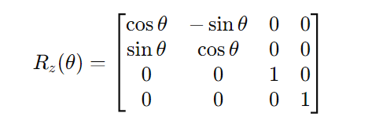
3. Rotation About the Z-Axis
A rotation by an angle 𝜃 about the z-axis affects the x and y coordinates.
The z-coordinate remains unchanged.
The x and y coordinates are rotated in the xy-plane.
The rotation matrix is:

Slide 19
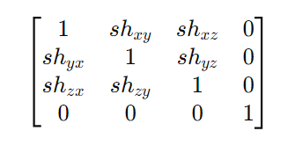
4. Shearing: Distorts the shape of the object.
The transformation matrix is:

Slide 20
Quaternion
Quaternions are a mathematical representation that extends complex numbers to four dimensions.
They are particularly useful in representing and computing rotations in 3D space.
Quaternions are widely used in computer graphics, robotics, and aerospace for smooth and efficient rotation calculations.
Representation:
q = a + bi + cj + dk
where:
a, b, c, and d are real numbers.
i, j, and k are the fundamental quaternion units.

Slide 21

Properties:
Component of a quaternion:
$i^{2}$= $j^{2}$ = $k^{2}$ = ijk = −1
ij=k, ji=−k, jk=i
kj=−i, ki=j, ik=−j
A quaternion can be divided into two parts:
Scalar part: a
Vector part: v = bi + cj + dk
Thus, a quaternion can be written as:
q=(a, v)

Slide 22
Operations with Quaternions
1. Addition
Quaternions are added component-wise, similar to vectors:
q1+q2 = (a1+a2) + (b1+b2)i + (c1+c2)j + (d1+d2)k
2. Multiplication
Multiplication of quaternions is not commutative (i.e., q1q2≠q2q1).
The product of two quaternions q1 and q2 is given by:
q1×q2 = (a1a2−b1b2−c1c2−d1d2) + (a1b2+b1a2+c1d2−d1c2)I + (a1c2−b1d2+c1a2+d1b2)j + (a1d2+b1c2−c1b2+d1a2)k

Slide 23

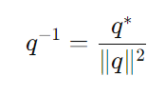
Conjugate
The conjugate of a quaternion 𝑞 = 𝑎 + 𝑏𝑖 + 𝑐𝑗 + 𝑑𝑘 is:
𝑞∗ = 𝑎 − 𝑏𝑖 − 𝑐𝑗 − 𝑑𝑘
4. Norm
The norm of a quaternion 𝑞 = 𝑎 + 𝑏𝑖 + 𝑐𝑗 + 𝑑𝑘 is:
Inverse
The inverse of a quaternion 𝑞 (assuming 𝑞 is non-zero) is:

Slide 24


Vector rotation using quaternion
Steps:
Represent the vector as a quaternion with a 0 as scalar part:
Compute the rotated vector:
The vector part of the resulting quaternion 𝑣′ is the rotated vector.

Slide 25
Thank You

